Slide 1
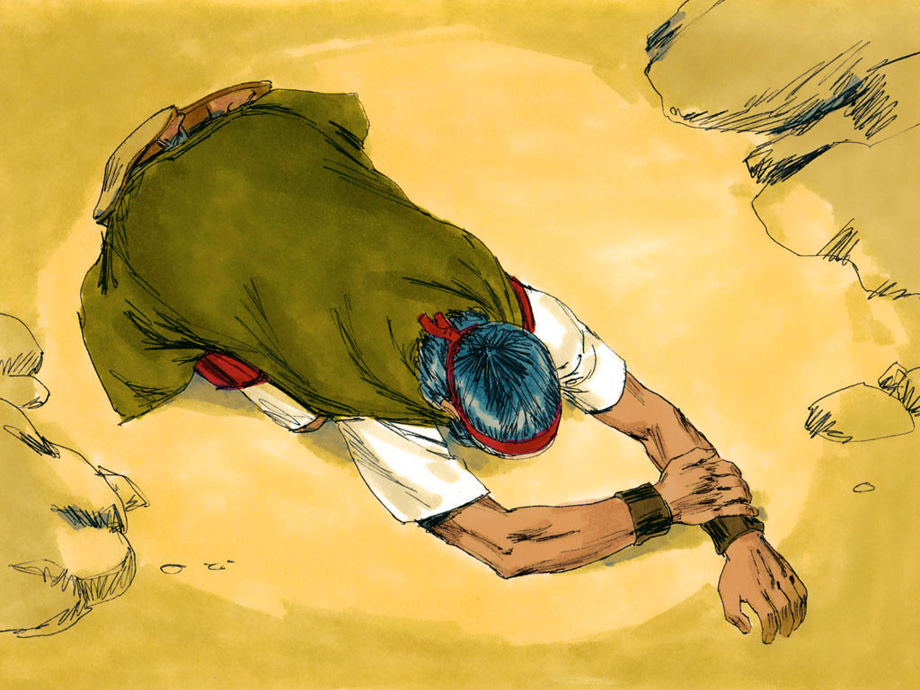
Notes:
Moses climbed up the mountain where God spoke to him. ‘You have seen how I brought you out of Egypt. Tell the Israelites, if you obey me, out of all the nations I will make you my treasured people, a kingdom of priests and a holy nation.’

Slide 2
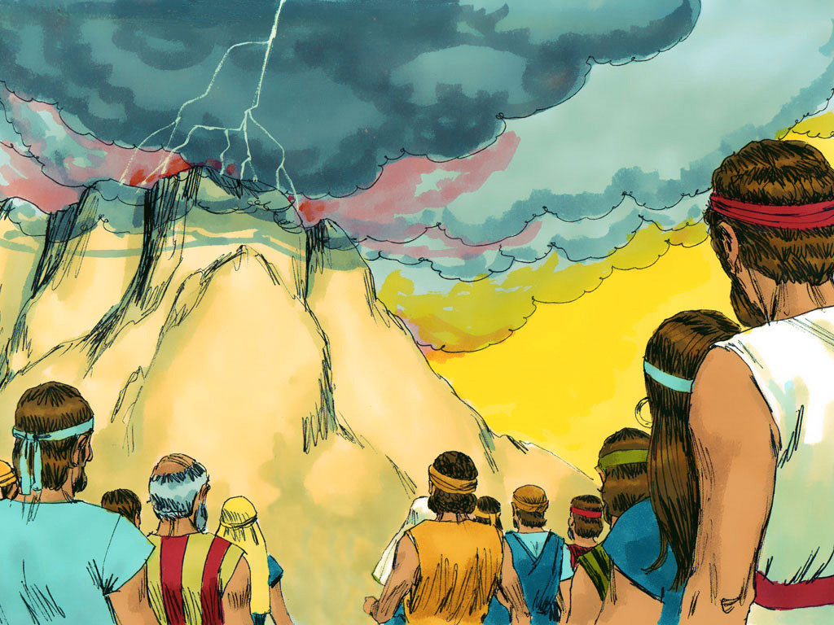
Notes:
The people below remained at a safe distance trembling with fear. God gave Moses more instructions to help them live at peace with Him and each other (Exodus 21-23).

Slide 3
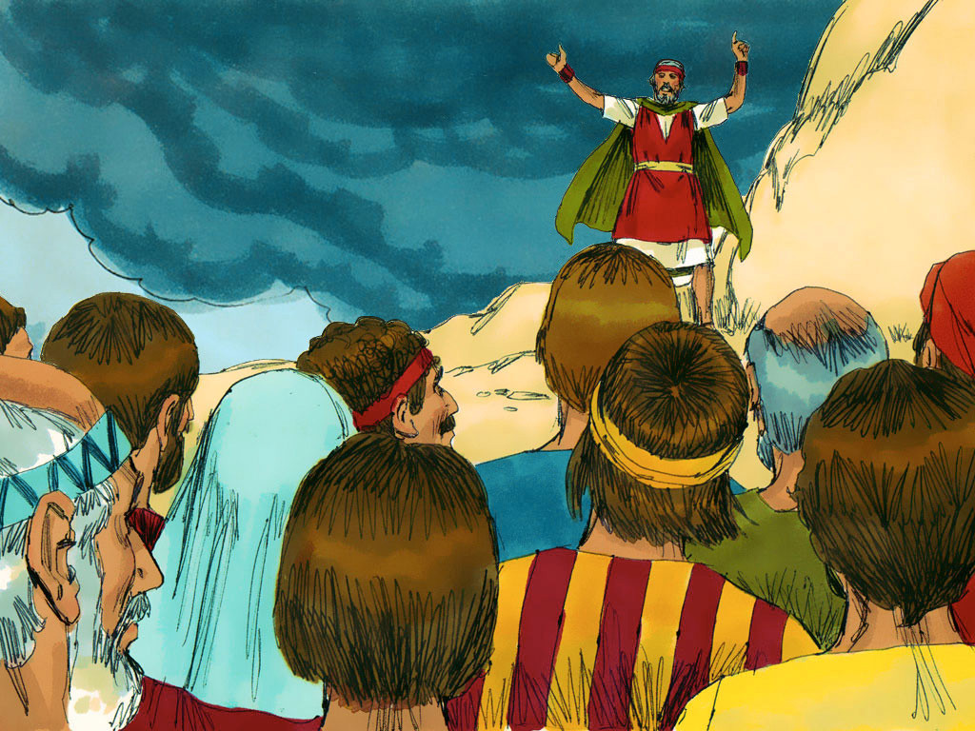
Notes:
Exodus 24 Moses wrote down God’s laws and then told everyone what God had commanded.

Slide 4
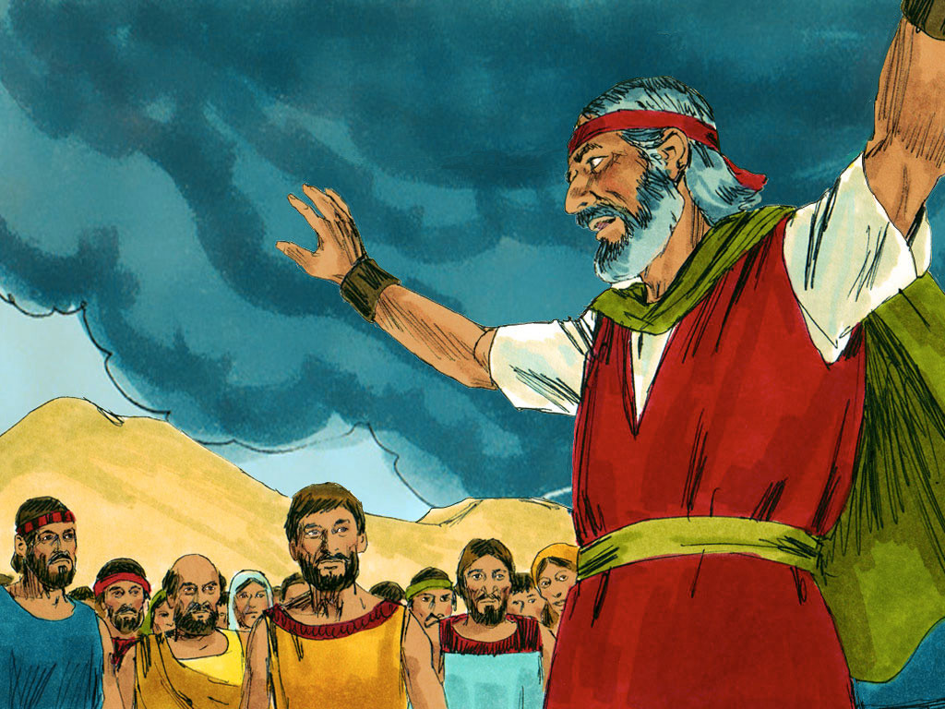
Notes:
‘We will do everything the Lord has said,’ they all replied.

Slide 5
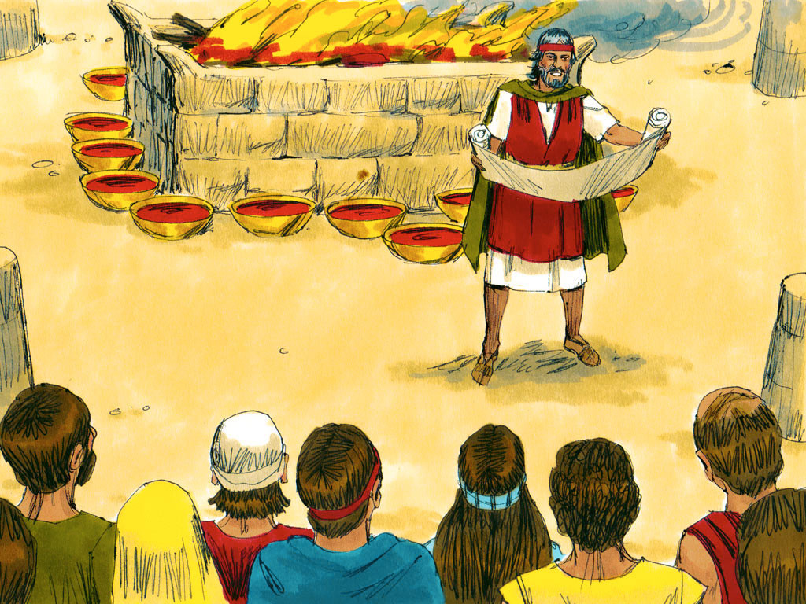
Notes:
The next morning Moses built an altar to God at the foot of the mountain. Young bulls were sacrificed and half of their blood was splashed on the altar with the rest put in bowls. Moses then read God’s laws to everyone again.

Slide 6
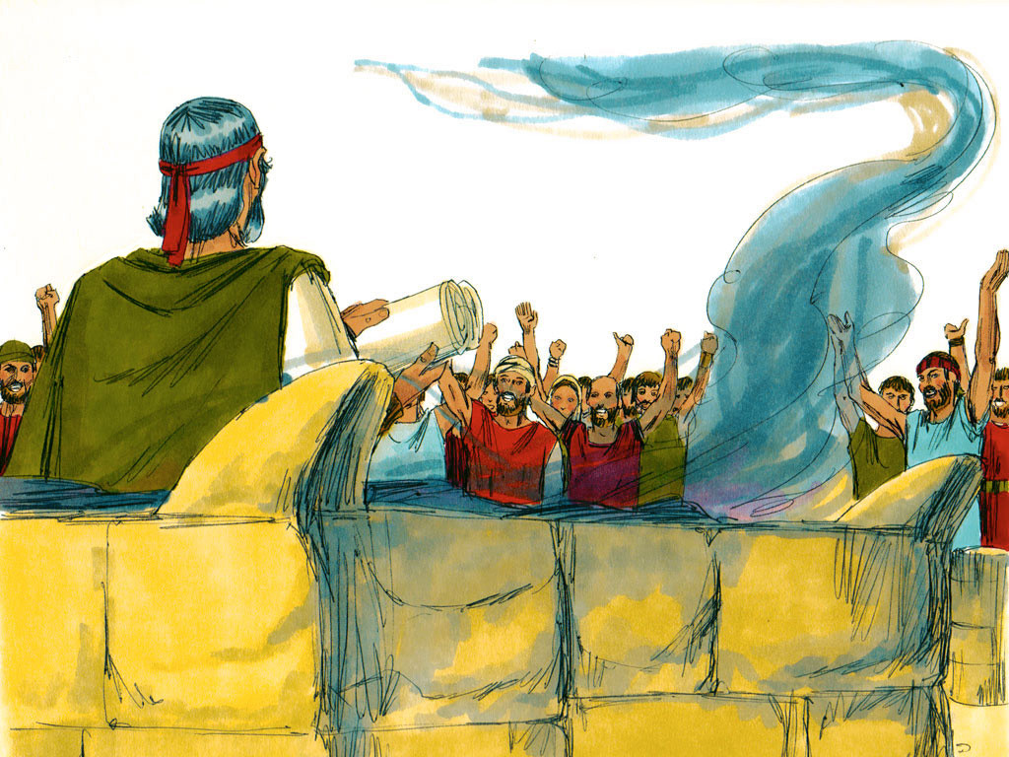
Notes:
‘We will do everything the Lord has said,’ they promised. ‘We will obey.’ Moses then sprinkled the blood on them and said, ‘This is the blood of the agreement (covenant) God has made with us.’

Slide 7
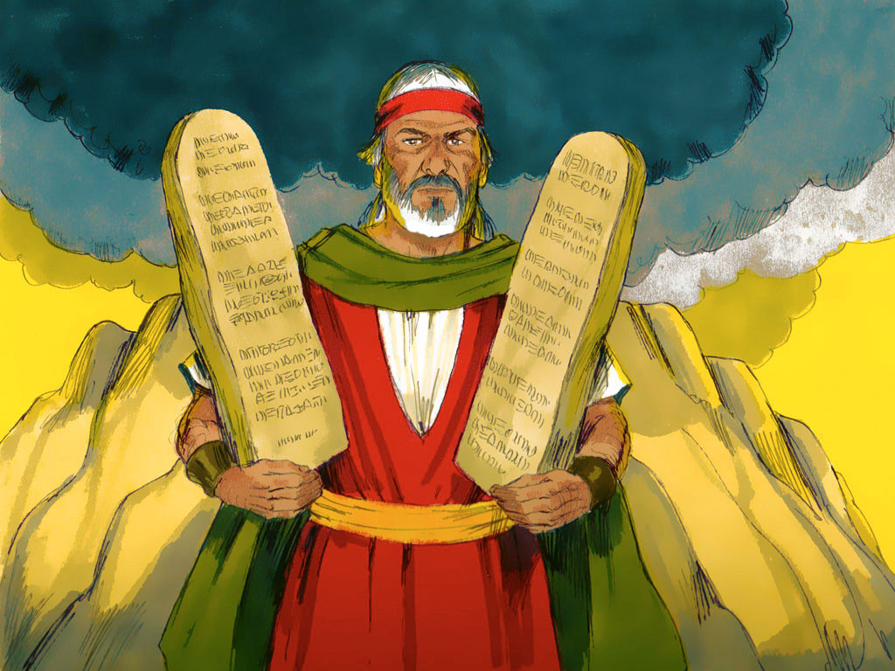
Notes:
The cloud covered the mountain for six days and then on the seventh God called to Moses. He went into the cloud where he stayed for 40 days and nights.

Slide 8


