Slide 1
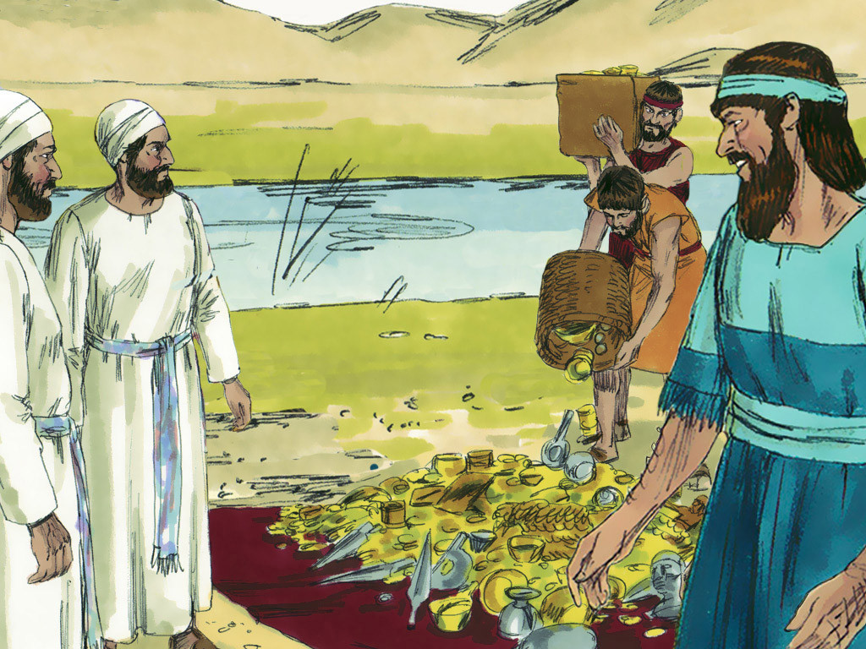
Notes:
Ezra chose 12 of the leading priests and weighed out the gold, silver and articles the King had given for the Temple in Jerusalem. He asked them to be responsible and guard 850 talents (29 metric tonnes) of treasures worth a fortune.

Slide 2
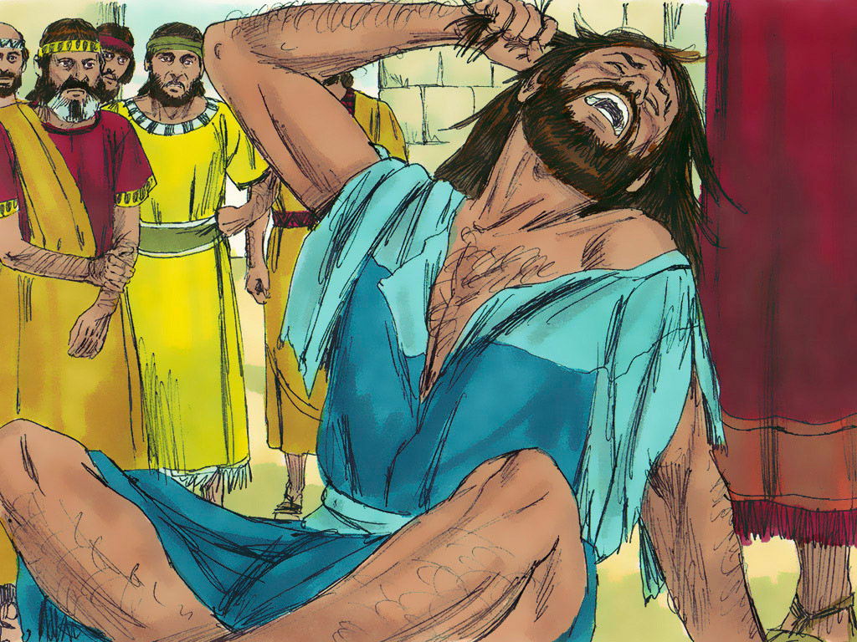
Notes:
Ezra was appalled at this news. He tore his tunic and cloak and pulled hair from his head and beard in grief. Those who loved and feared the Lord God gathered round Ezra. Ezra continued to show how upset he was about this disobedience until the time of the evening sacrifice.

Slide 3
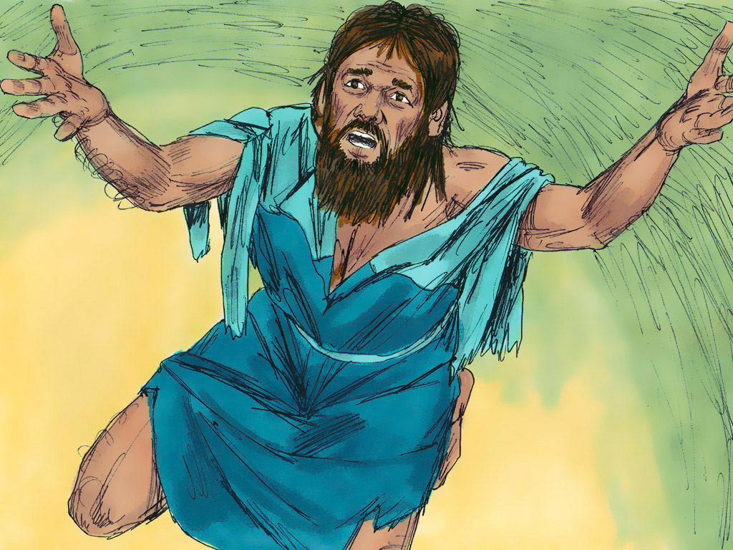
Notes:
He then fell on his knees with his arms outstretched to God and prayed. Ezra told God how ashamed he was of the sins of his people. As a result of their disobedience they had become captives but God had shown kindness in allowing them to return to their land. Now they were guilty of marrying people who worshipped idols and did detestable things. Ezra pleaded with God not to destroy them all.

Slide 4
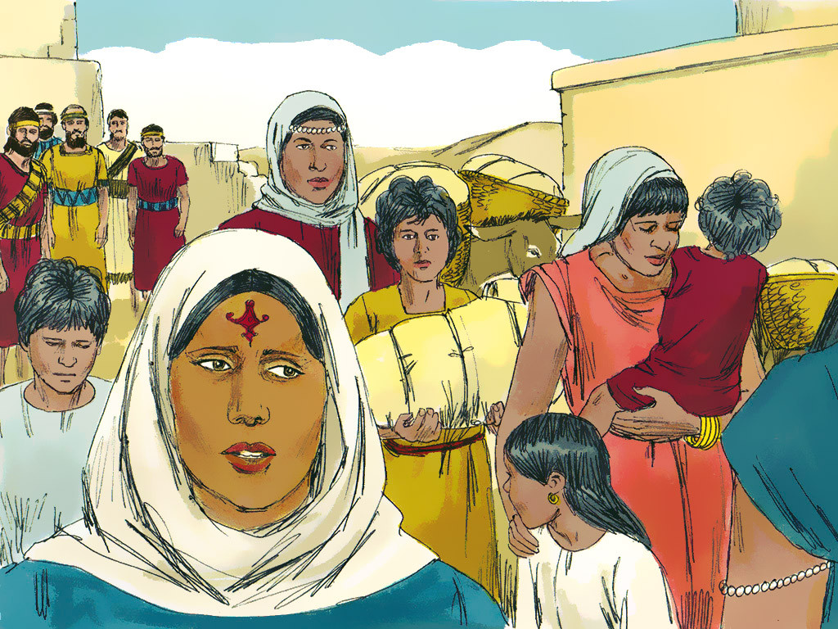
Notes:
The men with idol- worshipping wives made agreements to separate from them and gave offerings to God for their sins. Among those who had disobeyed God in this way were priests and Levites, musicians and Temple servants.

